Slide 1
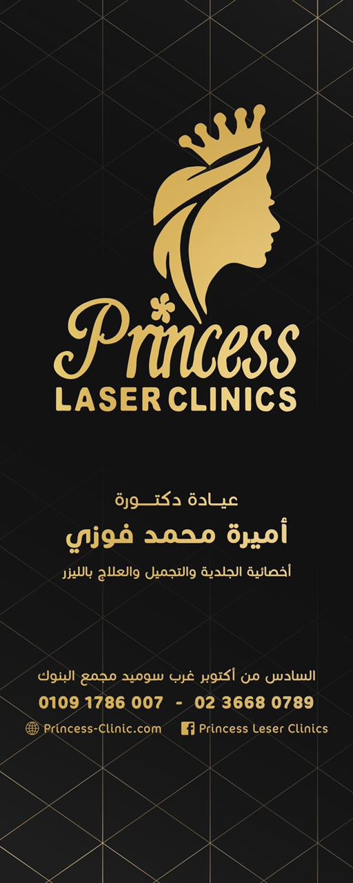

Slide 2
Princess Laser Clinic
Our motive:
It is our pleasure to partner with your University to help possible clients achieve their perfect appearance and fulfill their beauty goals.
We will achieve that by providing you with both the best possible prices while maintaining excellent service.

Slide 6
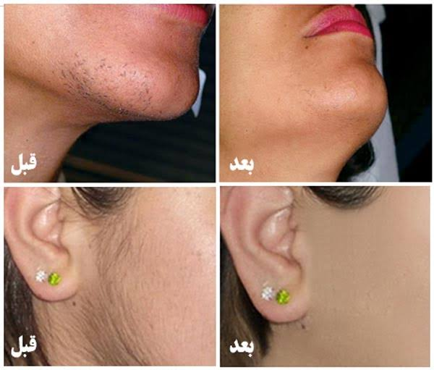
Laser Hair Removal Deka Motus 2022
Laser Hair Removal

Slide 8
Fractional laser CO2 -Rejuvenation -Skin tags removal -Warts removal -Scars treatment -Wide pores treatment

Slide 10
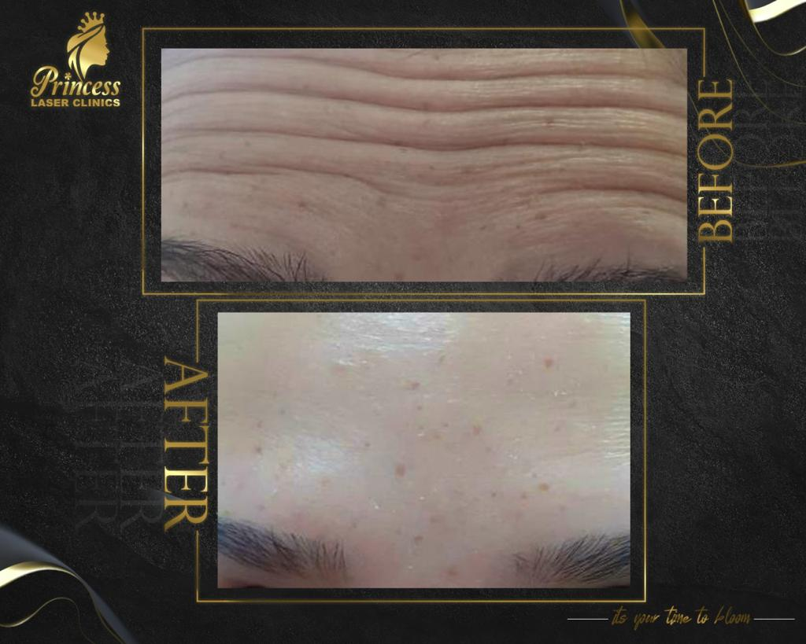
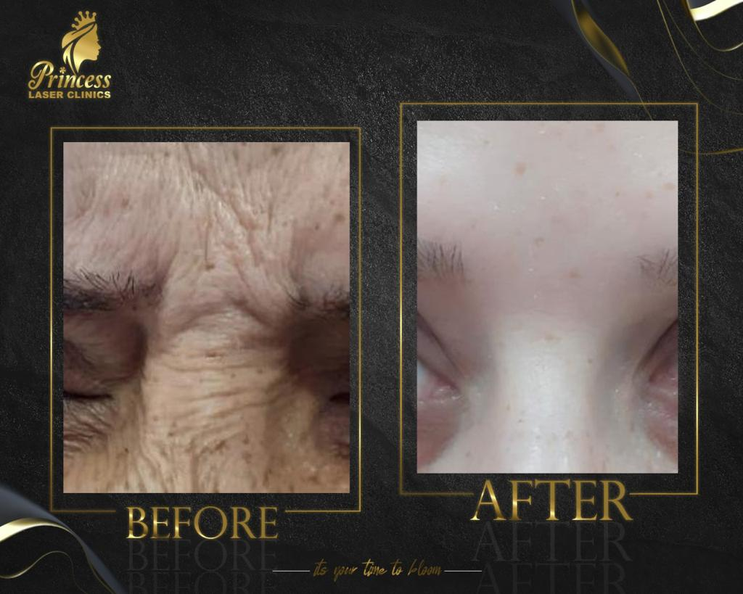
Botox -Fine and deep wrinkles -Hyperhidrosis for hands , feet and underarms

Slide 11
Filler -Treatment of dark circles -Fading away laugh lines -Definition of the jaw -Cheek and chin augmentation -Clearing neck lines -Scars treatment -Fine and deep wrinkles.

Slide 12
-Plasma Injection: -For hair growth -Face rejuvenation
-Mesotherapy:
-Whitening
-Wide pores
-Double chin
-Dark hallows
-Hair growth
-Acne Scars
-Hyper pigmentation

Slide 13
Hydra Facial Deep face cleaning in 9 steps

Slide 14
Peeling
-Treatment of hyperpigmentation
-Rejuvenation
-Treatment of dark circles
Mesobotox
-Treatment of hyperhidrosis of the face
-Improvement of oily skin
-Improvement of scars and wide pores

Slide 15
Princess Laser Clinic
has the pleasure to offer a 25% discount on
hair removal
Fractional laser
Plasma and Mesotherapy injection
Hydrafacial and peeling
10% discount on
Filler and Botox
for all MSA staff , students and alumni on all our services.

